Slide 1

P peline
The Data
D3 & Mobile
© Jennifer Mankoff
The Data Pipeline; HCII; Spring 2014

Slide 2
Mobile Data
Increasingly prevalent; increasingly rich
Great source of context
(information that can be used [acted on, displayed]
to characterize the setting in which the user is
operating)
Common uses of context
location aware services
adaption to changes in environment
retro-active understanding of users

Slide 3
Sensors
Accelerometer
Applications
Battery
Bluetooth
Calls
Messaging
Gravity
Gyroscope
Light
Linear Accelerometer
Location
Magnetometer
Network Usage
Orientation
Pressure
Processor
Proximity
Rotation
Screen
Telephony
Temperature
Traffic
Wi-Fi
… many more

Slide 4



AWARE framework
Sense, store & share
Reuse, interact & understand
Developers
AWARE
Context
Researchers
Abstract & Simplify

Slide 5
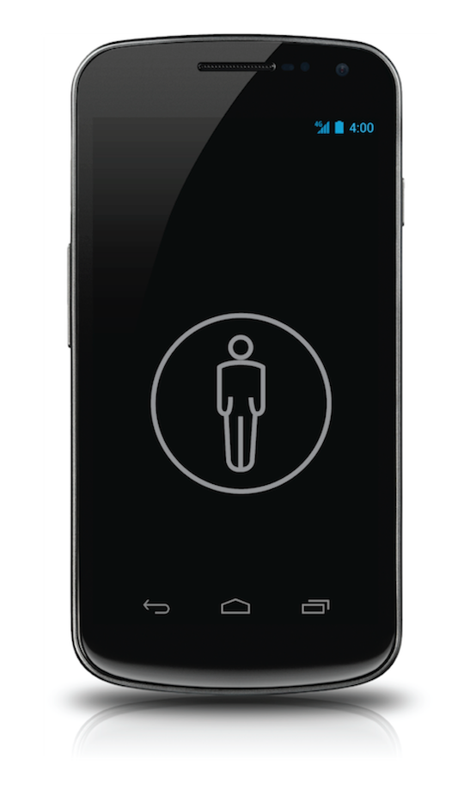
Plugins help:
Diet tracking
application
Accelerometer
Step counter
(plugin)
Activity Recognition
(plugin)
Calorie counter
(plugin)
noisy data
Mobility
application
REUSABILITY is the key here!

Slide 6
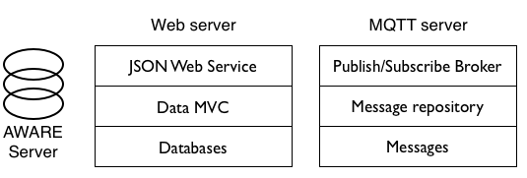
AWARE Server
Tables we will use are documented in the byte

Slide 7
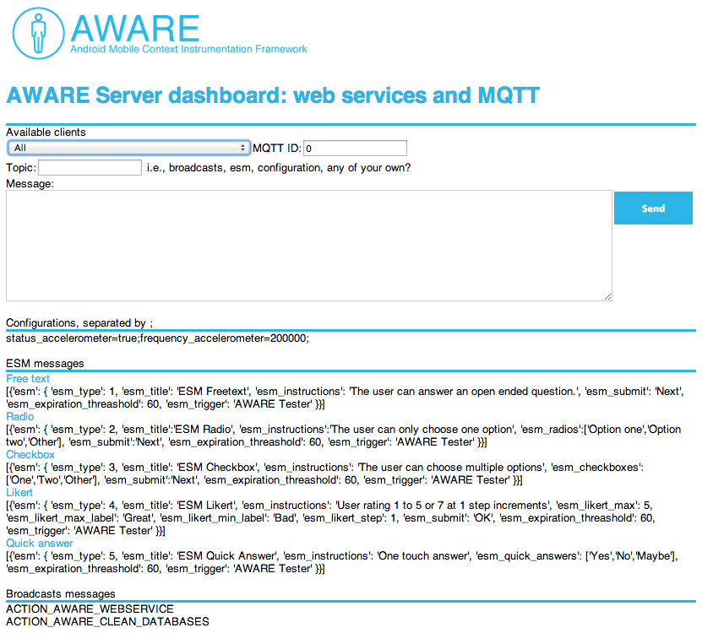
AWARE Server dashboard

Slide 8
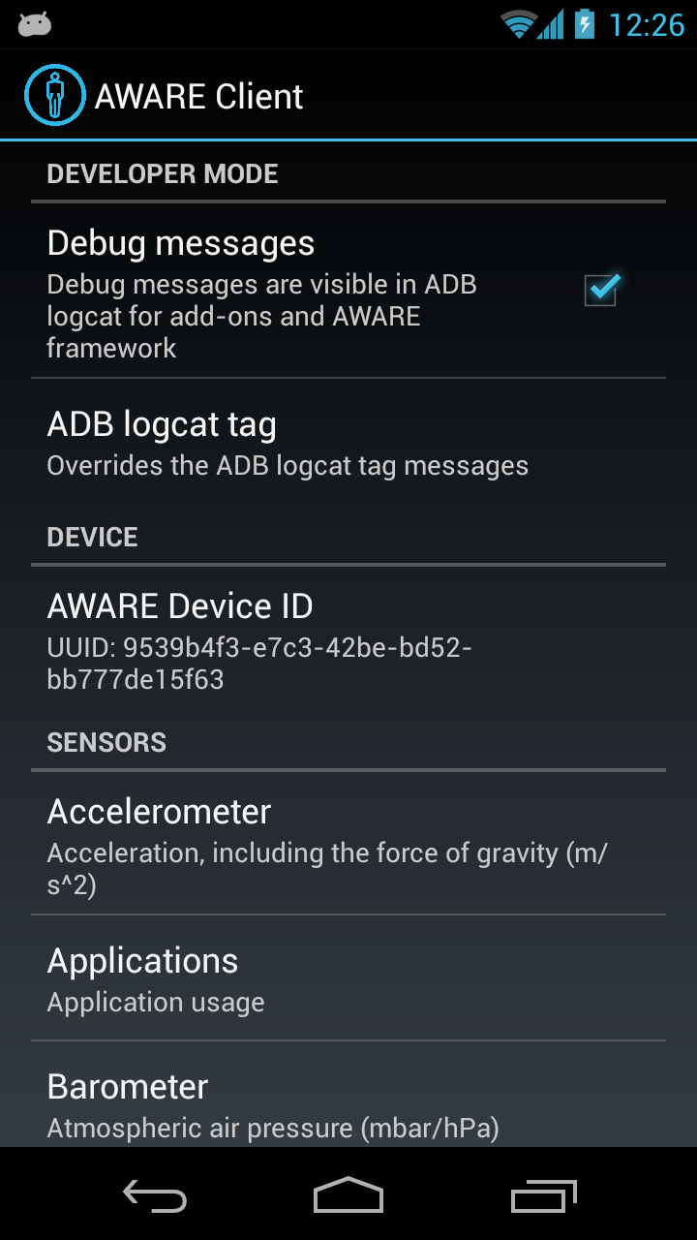
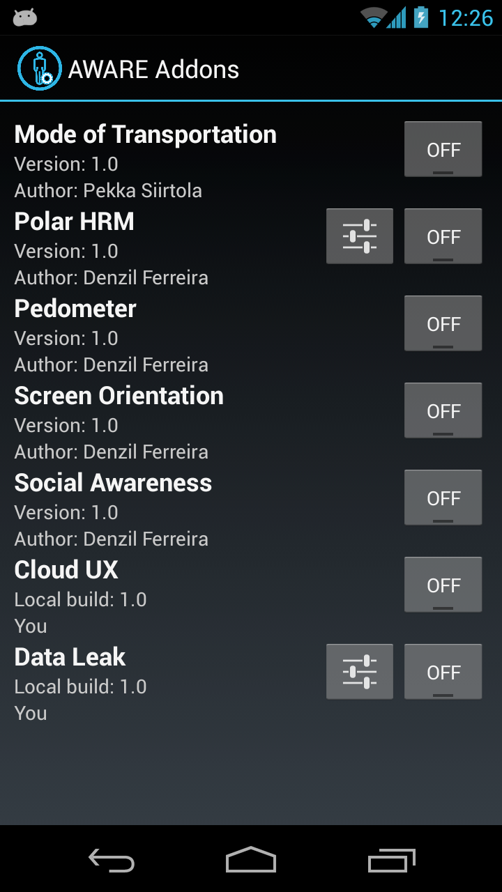
AWARE Client

Slide 9
What do we need to do with mobile data?
Cleaning: can you tell when the phone is off? (not a focus of this byte)
Organizing: identifying common locations (what the byte walks you through)
Associating: connecting activities to other context (we explore location + activity, homework is to explore time + activity)

Slide 10
If you want to explore more
http://data.cmubi.org/assignments/byte4mobiledata
http://data.cmubi.org/classroom-news/byte4results

Slide 11
Introducing Visualization: D3
http://techslides.com/over-2000-d3-js-examples-and-demos/
http://bl.ocks.org/mbostock

Slide 12
D3 Uses Web Standards
D3 = Data-Driven Documents
Uses:
HTML (sometimes) + SVG (vector graphics for the web) for content
<!DOCTYPE html> <meta charset="utf-8”> <body>
<svg width="960" height="500”> <text y="12”> Hello, world! </text> </svg>
</body>
Notes:
----- Meeting Notes (2/6/14 09:50) -----
missing body here

Slide 13
D3 Uses Web Standards
D3 = Data-Driven Documents
Uses:
HTML + SVG for content
CSS for aesthetics
<!DOCTYPE html> <meta charset="utf-8”>
<style> body { background: steelblue; } </style>

Slide 14
CSS Selections
Body is a reference to parts of your html
body { background: steelblue; }
You can use other options
#rect
rect
.rect
[color=red]
color red
rect.rounded
rect#rounded
<any id=“rect”>
<rect>
<any class=“rect”>
<any color=“red”>
<color><red></color>
<rect class=“rounded”>
<rect id=“rounded”>

Slide 15
Example use of CSS in Byte3
text:hover {
fill: orange;
}

Slide 16
D3 Uses Web Standards
D3 = Data-Driven Documents
Uses:
HTML + SVG for content
CSS for aesthetics
JavaScript for interaction
Interoperate seamlessly through manipulating the Document Object Model
Great debugging support in browsers

Slide 17
Using D3
<!DOCTYPE html> <meta charset="utf-8”> <style>/* CSS */</style>
<body> <script src="d3.v2.js"></script> <script>/* JavaScript */</script>
</body>

Slide 18
Setting up an axis
// collect data from Python
var frequency_list = {{wordcloud|safe}}

Slide 19
Setting up an axis
// collect data from Python
var frequency_list = {{wordcloud|safe}}
Tells javascript not to escape any characters (the data is already ‘safe’)

Slide 20
Setting up an axis
// collect data from Python
var frequency_list = {{wordcloud|safe}}
// set up the color axis scale to go from 0 to 100
var color = d3.scale.linear()
.domain([0,1,2,3,4,5,6,10,15,20,100])
.range(["#ddd", "#ccc", "#bbb", "#aaa", "#999", "#888", "#777", "#666", "#555", "#444", "#333", "#222"]);
Notes:
----- Meeting Notes (2/6/14 09:50) -----
change x to x_scale

Slide 21
Setting up an axis
// collect data from Python
var frequency_list = {{wordcloud|safe}}
// set up the color axis scale to go from 0 to 100
var color = d3.scale.linear()
.domain([0,1,2,3,4,5,6,10,15,20,100])
.range(["#ddd", "#ccc", "#bbb", "#aaa", "#999", "#888", "#777", "#666", "#555", "#444", "#333", "#222"]);
Range is the range of the axis in svg coordinates. Here we provide a range in terms of colors.
Notes:
----- Meeting Notes (2/6/14 09:50) -----
change x to x_scale

Slide 22
Creating the word cloud
// create the cloud
d3.layout.cloud().size([800, 300]) .words(frequency_list)
.rotate(0)
.fontSize(function(d) { return d.size; })
.on("end", draw)
.start();

Slide 23
Setting up a drawing canvas
// create the drawing area
d3.select("body").append("svg")
.attr("width", 850)
.attr("height", 350)
.attr("class", "wordcloud")
.append("g”)
.attr("transform", "translate(320,200)”)
…
Append adds something to a selection (you could add an ‘h1’ (to body), a ‘circle’ (to an svg), and so on.

Slide 24
Setting up a drawing canvas
Append also returns a new selection which you can modify as is done below it. D3 uses chained function calls to apply attributes to the current selection (the svg just appended)
// create the drawing area
d3.select("body").append("svg")
.attr("width", 850)
.attr("height", 350)
.attr("class", "wordcloud")
.append("g”)
.attr("transform", "translate(320,200)”)
…

Slide 25
Setting up a drawing canvas
// create the drawing area
d3.select("body").append("svg")
.attr("width", 850)
.attr("height", 350)
.attr("class", "wordcloud")
.append("g”)
.attr("transform", "translate(320,200)”)
…
without the transform, words would get cutoff to the left and top, they would appear outside of the SVG area

Slide 26
Mapping Data to DOM elements
// create the drawing area
d3.select("body").append("svg")
…
.selectAll("text")
.data(words)
.enter().append("text")
.style(…)
.text(function(d) { return d.text; });

Slide 27
Mapping Data to DOM elements
// create the drawing area
d3.select("body").append("svg")
…
.selectAll("text")
.data(words)
.enter().append("text")
.style(…)
.text(function(d) { return d.text; });
This use of selectAll specifies that the contents of data should map onto any text in the svg

Slide 28
Mapping Data to DOM elements
// create the drawing area
d3.select("body").append("svg")
…
.selectAll("text")
.data(words)
.enter().append("text")
.style(…)
.text(function(d) { return d.text; });
BUT!!!! The text doesn’t exist yet. You’re just telling d3 that when they do they should correspond to data

Slide 29
Mapping Data to DOM elements
// create the drawing area
d3.select("body").append("svg")
…
.selectAll("text")
.data(words)
.enter().append("text")
.style(…)
.text(function(d) { return d.text; });
(for each data point; implicitly)
enter() creates the missing text and returns it

Slide 30
Mapping Data to DOM elements
// create the drawing area
d3.select("body").append("svg")
…
.selectAll("text")
.data(words)
.enter().append("text")
.style(…)
.text(function(d) { return d.text; });
This tells enter() what to create. enter() adds it to the parent node (the svg in this case)

Slide 31
Mapping Data to DOM elements
// create the drawing area
d3.select("body").append("svg")
…
.selectAll("text")
.data(words)
.enter().append("text")
.style(…)
.text(function(d) { return d.text; });
That implicit for loop binds ‘d’ to the current piece of data. Here we retrieve d’s text (the word to be displayed)

Slide 32
What data do we need?
Coming from Python:
[{’text': “dog”, ’size': 20}, {’text': “cat”, ’size': 3} ,…]

Slide 33
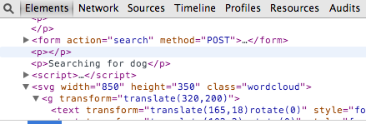
The result:

Slide 34
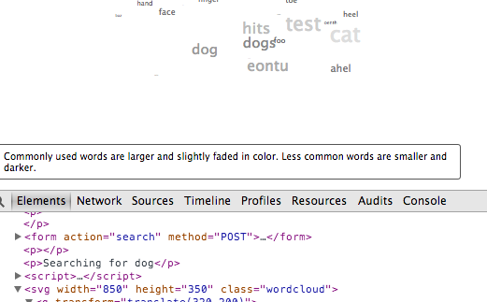
Debugging
Option-Command-I : Developer Tools in Chrome
Option-Command J : JavaScript Console

